Slide 1
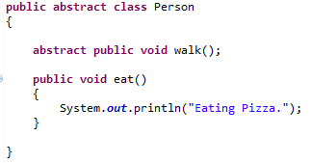
Abstract class in Java
A class that is declared with abstract keyword, is known as abstract class in java.
It can have abstract and non-abstract methods (method with body).

